Slide 1



Summer 2024
NutriVitality: A Healthcare and Nutrition Tracking System
Done by: Haydar Mohamad
Advisor: Dr. Kassem Danach

Slide 2

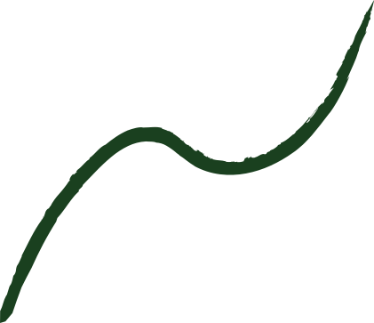


01
Outline
System Analysis
Introduction
Conclusion
Literature Review

Slide 3

02
Introduction
It is a comprehensive software solution that is designed for healthcare facilities, to facilitate the monitoring, tracking, and management of individual health, and nutrition goals.

Slide 4

03
Objectives
Enhance efficiency, reduce manual tasks, and optimize procedures.
Assess acceptance by professionals and training effectiveness.
Evaluate sustainability, adaptability, and support.
Measure response time and performance during peak demand.

Slide 5

04
Aim
To develop a comprehensive and efficient system.
To streamline healthcare procedures.
To ensure user satisfaction, and adaptability to emerging technologies.
To ultimately improve patient outcomes and operational effectiveness

Slide 6

Problem
05
Diverse platforms struggle in communication
Difficulties healthcare providers have in adapting to new systems.
The user base and data volume is growing.
Ensuring the confidentiality and integrity of patient health data.

Slide 7

06
Litearture Review
These systems promote proactive health management.
Technology has revolutionized healthcare.
Systems are public, academic, school, and special.
Digital medical records have transformed tracking.
New apps enhance user experience and system integration.

Slide 8
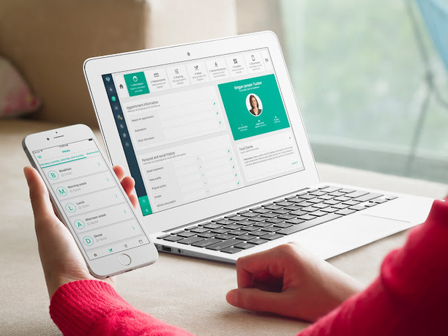
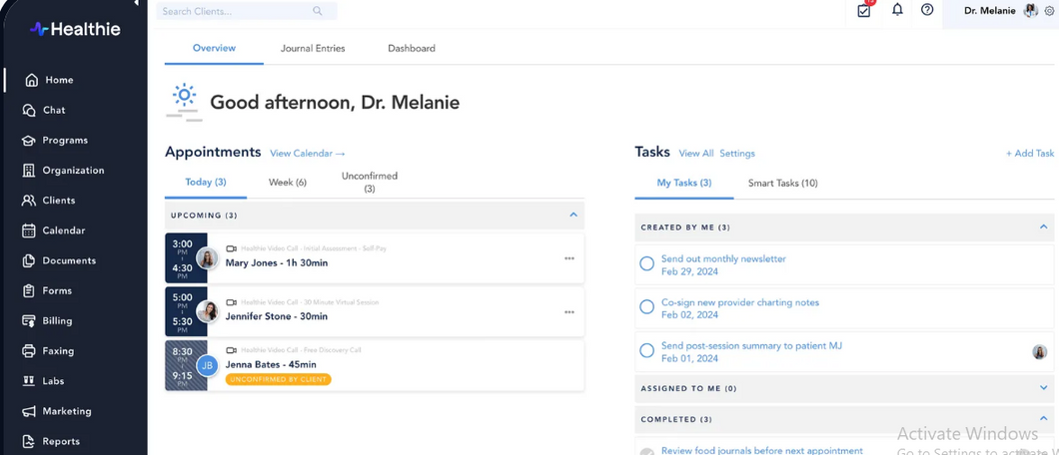
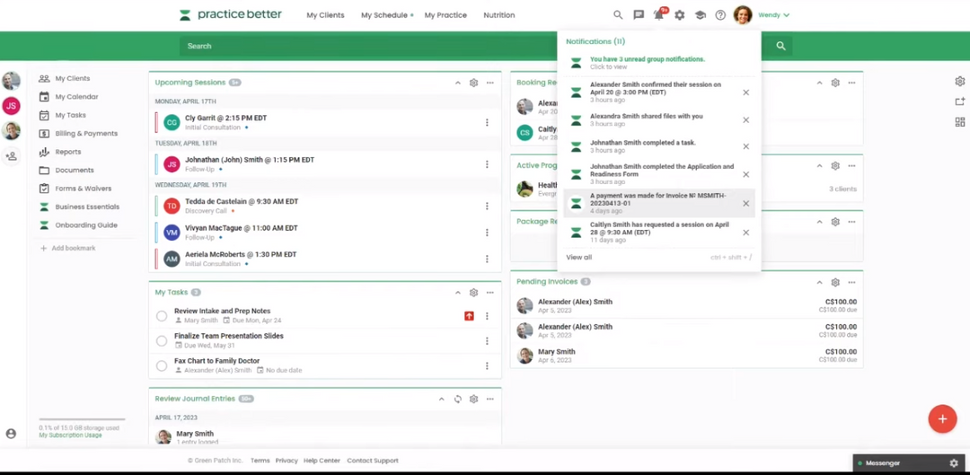
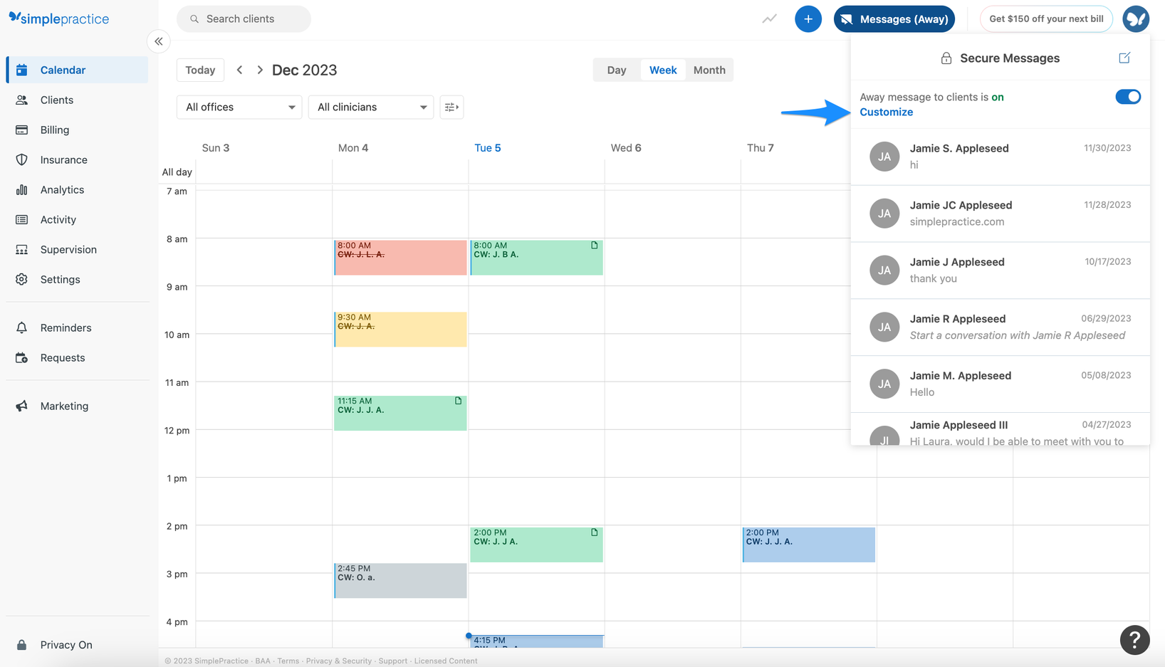
07
Similar Works
Nutrium
Healthie
Practice Better
Simple Practice

Slide 9
08
Why NutriVitality?
It utilizes a highly secure login system.
It offers a complete suite of functionalities .
It is designed for simplicity and ease of use.
It includes backup and restore settings.

Slide 10

09
System Analysis and Design
This phase is crucial in developing effective information systems because:
It helps clarify business objectives and user needs.
It enhances system performance.
It reduces the risk of errors and failures.
It allows adaptability to future changes.

Slide 11

10
Development Method: Water-Fall Model
Requirement Gathering
System Design
Implementation
Integration and testing
Maintenance

Slide 12
11
System Design: UML
In this section, we will explore the various design diagrams used to illustrate the architecture, data flow, and functionality of the Healthcare and Nutrition Tracking System.

Slide 13
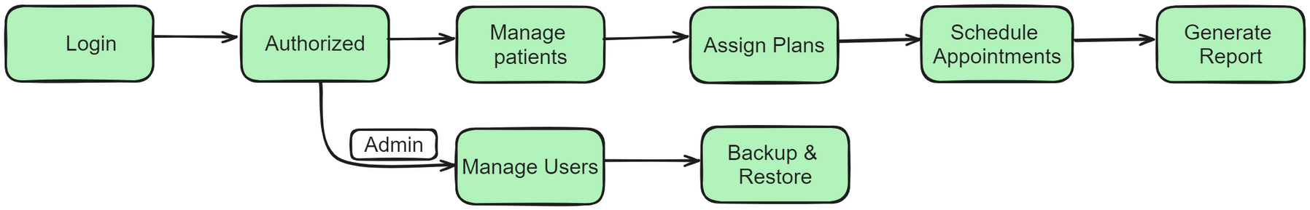
12
System Design: Activity Diagram
It illustrates the workflow of a system's processes, highlighting the sequence and flow of activities. It helps visualize dynamic aspects of the system, showcasing the flow of control between activities

Slide 14
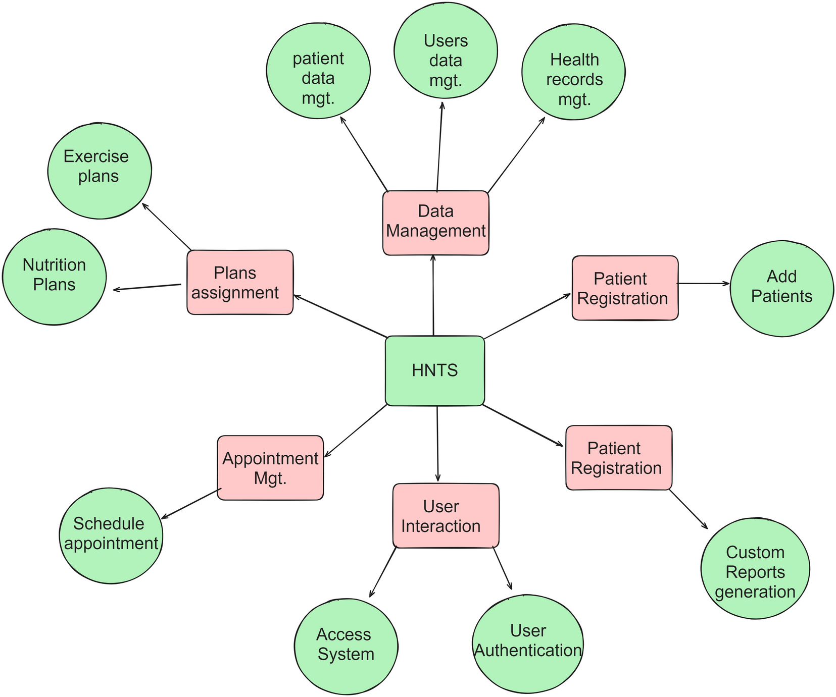
13
System Design: Data Flow Diagram
It is used to visualize the movement of data between external entities, processes, and data stores, facilitating the understanding of system functionality and data interactions

Slide 15
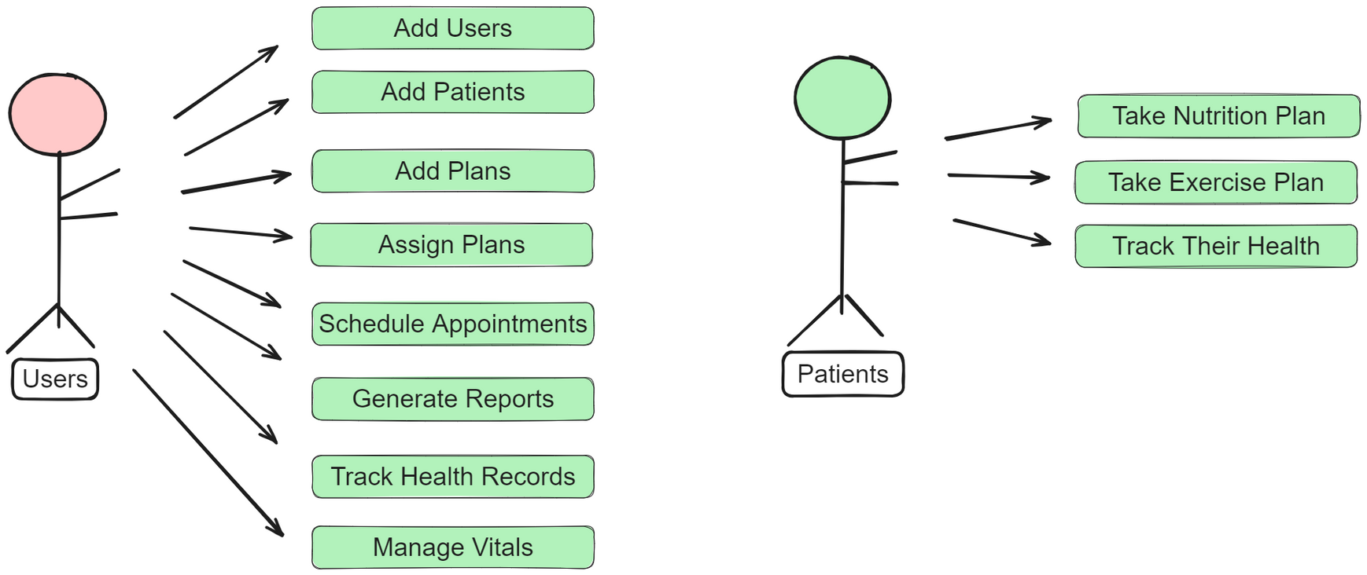
14
System Design: Use Case Model
It illustrates how users engage with the system to achieve specific goals, providing a clear understanding of system functionality and user needs

Slide 16
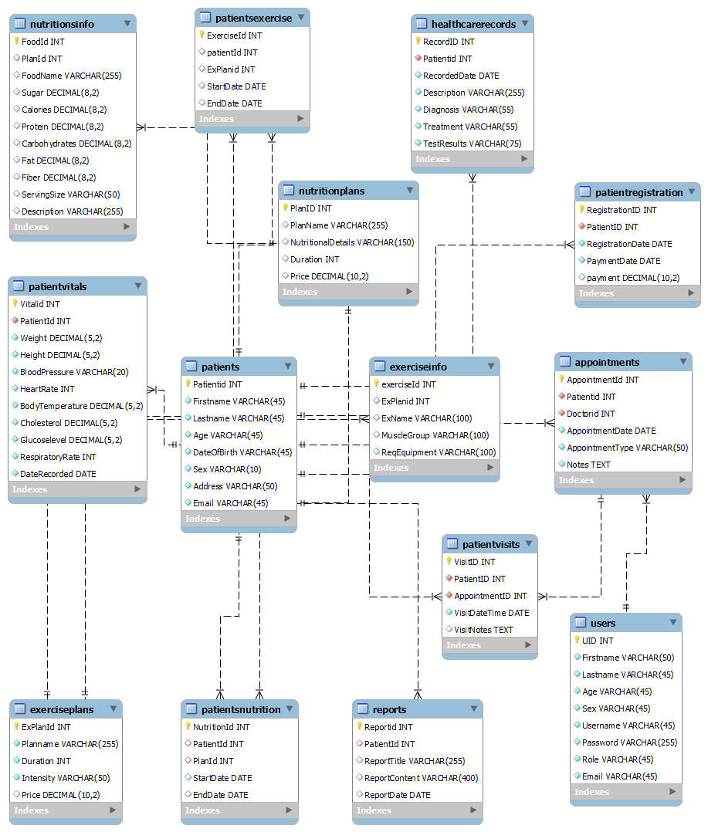
15
System Design: ERD
It is used to model the logical structure of databases, helping to design and organize data efficiently

Slide 17
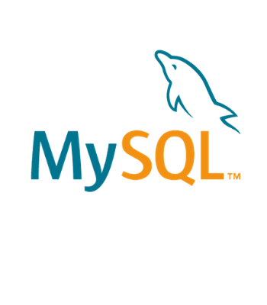

16
Visual Studio IDE was used as a development tool healthcare and nutrition tracking system
Development Technologies
MySQL database was used to design the system’s database, depicting all the system’s entities

Slide 18
Conclusion
By combining technological advancements with effective management practices, a healthcare and nutrition tracking system will benefit healthcare providers by organizing
and optimizing various healthcare processes efficiently including managing patient’s health, tracking vitals, and user management
And now onto NutriVitality

